Slide 1
Applications on Azure: Putting All the Pieces Together
James Chambers | Software Engineer, Microsoft MVP
Simon Timms | Software Engineer, Microsoft MVP

Slide 2

Meet James Chambers | ‏@CanadianJames
Senior Software Engineer
Background in healthcare, telecom, transportation ++
Currently focusing on building things that scale
Author, Speaker Mentor
Founding member of Western Devs
Frequent contributor to user groups, brown bags and conferences
Four-time ASP.NET/IIS MVP

Slide 3
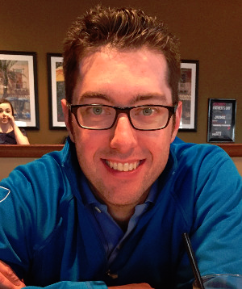
Meet Simon Timms | ‏@stimms
Senior Software Engineer
Spent years working on Linux, Unix and even z/OS
Lots of oil and gas experience
Author, Speaker Mentor
Founding member of Western Devs
Calgary .net User Group
Two time MVP in ASP.net

Slide 4
Topics

Slide 5
Course Topics
Applications on Azure: Putting All the Pieces Together
01 | Intro | 05 | Storing Data and Objects in Azure
02 | Exploring Application Architecture | 06 | ElasticSearch, Docker and YOU
03 | Working with Azure DNS Services | 07 | Scaling Your Application Under Load
04 | Executing Large Tasks in the Cloud | 08 | Rewind

Slide 6
Setting Expectations
Target Audience
People who know about computers
Developers. Could be .net but for most of this stuff it doesn’t matter
Suggested Prerequisites/Supporting Material
Rudimentary knowledge of Azure
Some understanding of distributed systems

Slide 7
Azure

Slide 8
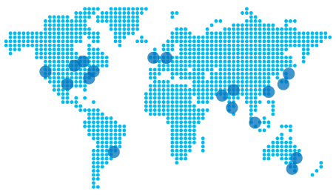
Regions
Notes:
These are all the regions
5 in the US, + two government ones
Two in Europe
Hong kong
singapore
2 in japan
Brazil
2 in Australia
3 in india
Coming 2 in Canada some time in 2016 Toronto and Quebec City

Slide 9
PaaS, SaaS, IaaS,
Notes:
Aardvark, aardwolf, bazaar all other words with two As in them
Hanselman’s explination of taxi, rental car and owning a car

Slide 10
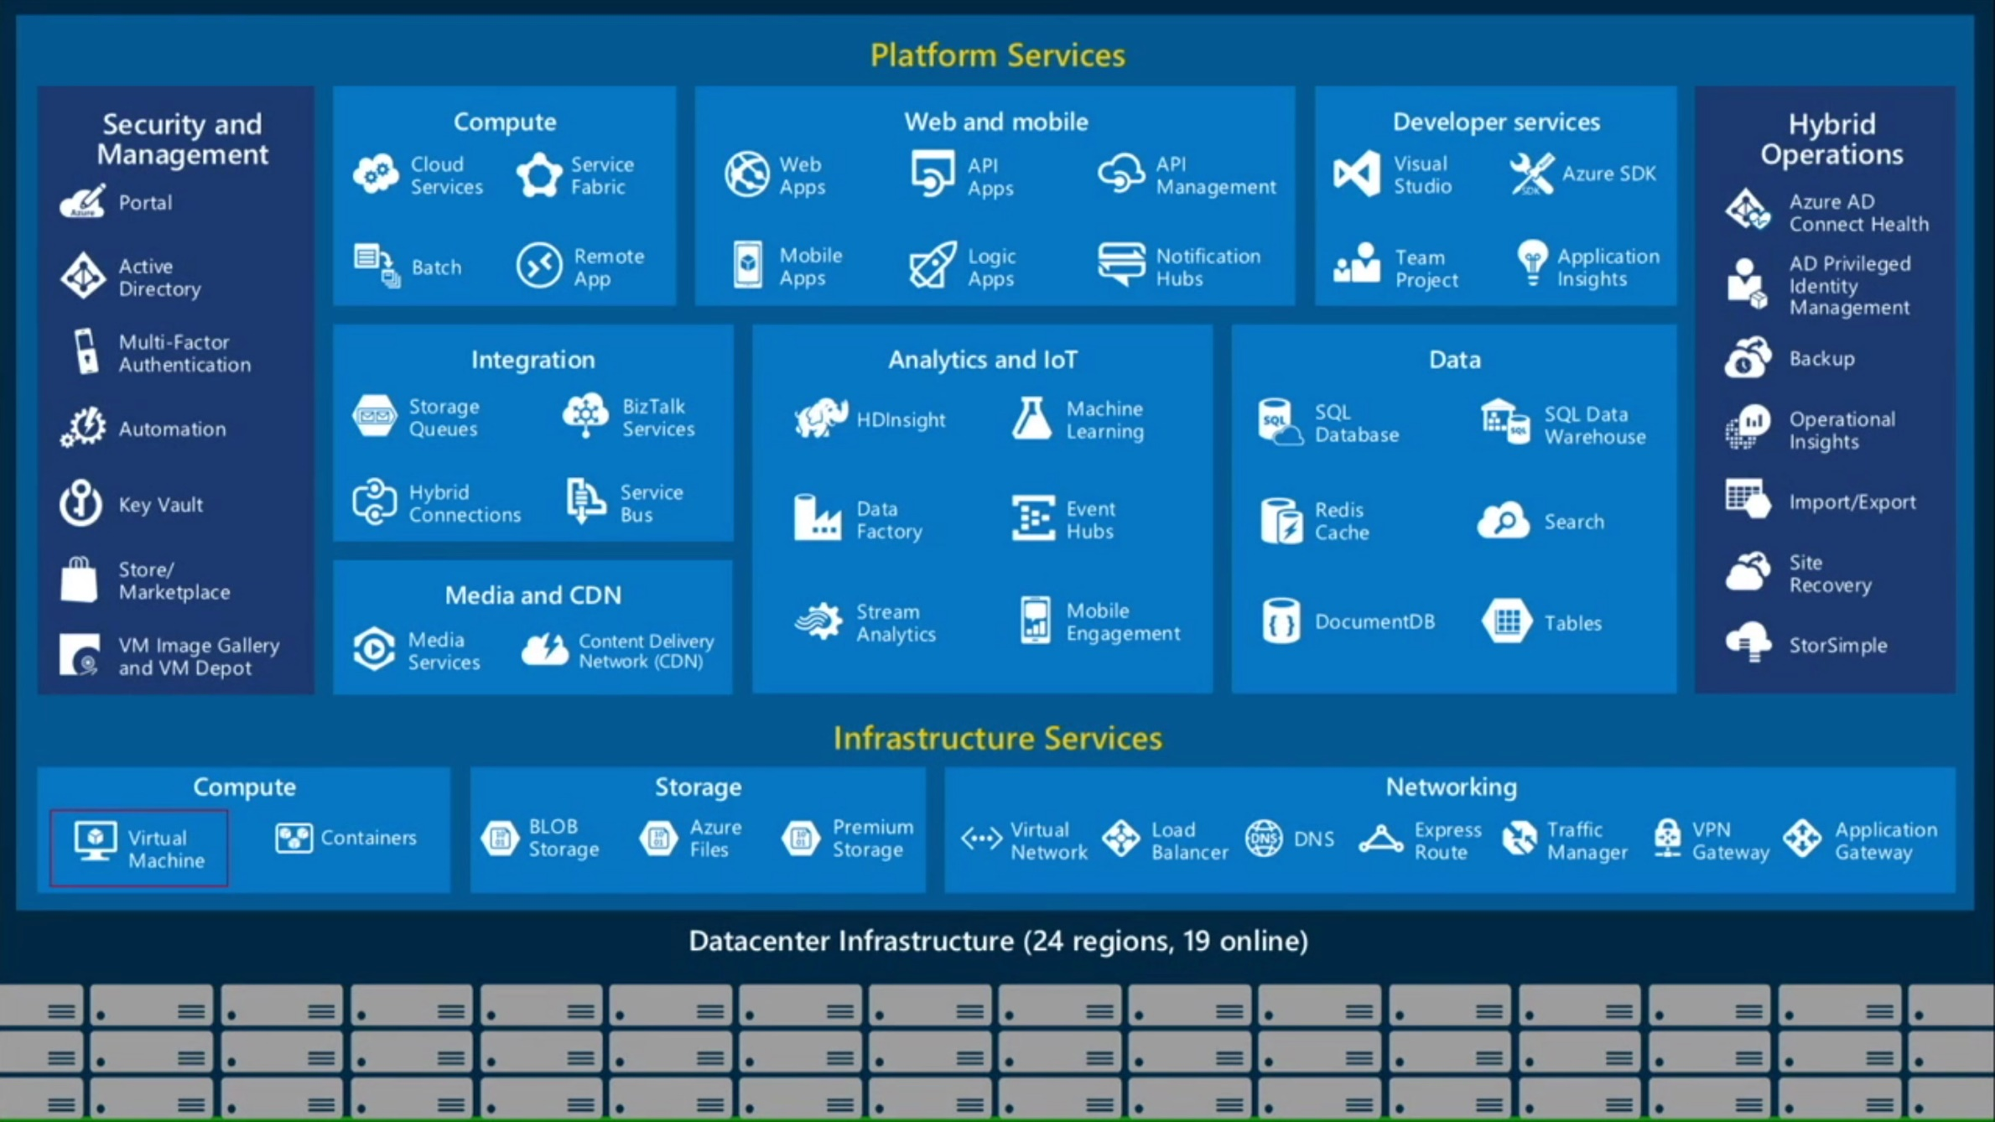
Azure is All Things

Slide 11
Bits of Azure

Slide 12
Recommended Reading
https://azure.microsoft.com/en-us/documentation/articles/fundamentals-introduction-to-azure/

